Slide 1
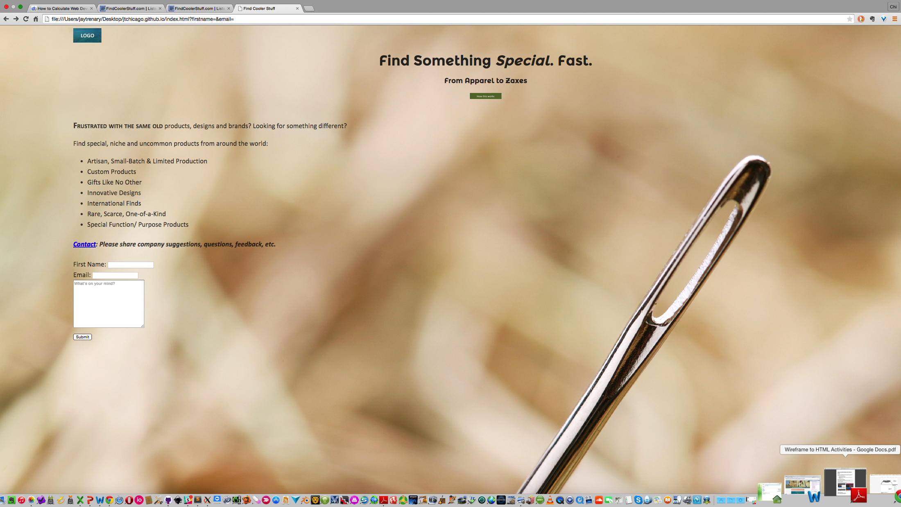
Test: Montserrat 700 alternative
I only focused on a typeface/ font for the header section
Want something that looks contemporary, sans-serif, but not so common-looking that it’s not distinctive in any way
Like this one, but the cap “F” looks strange and a little distracting to me
Some of the letters also look a little “cursivey” to me and kind of blend together IMO

Slide 2
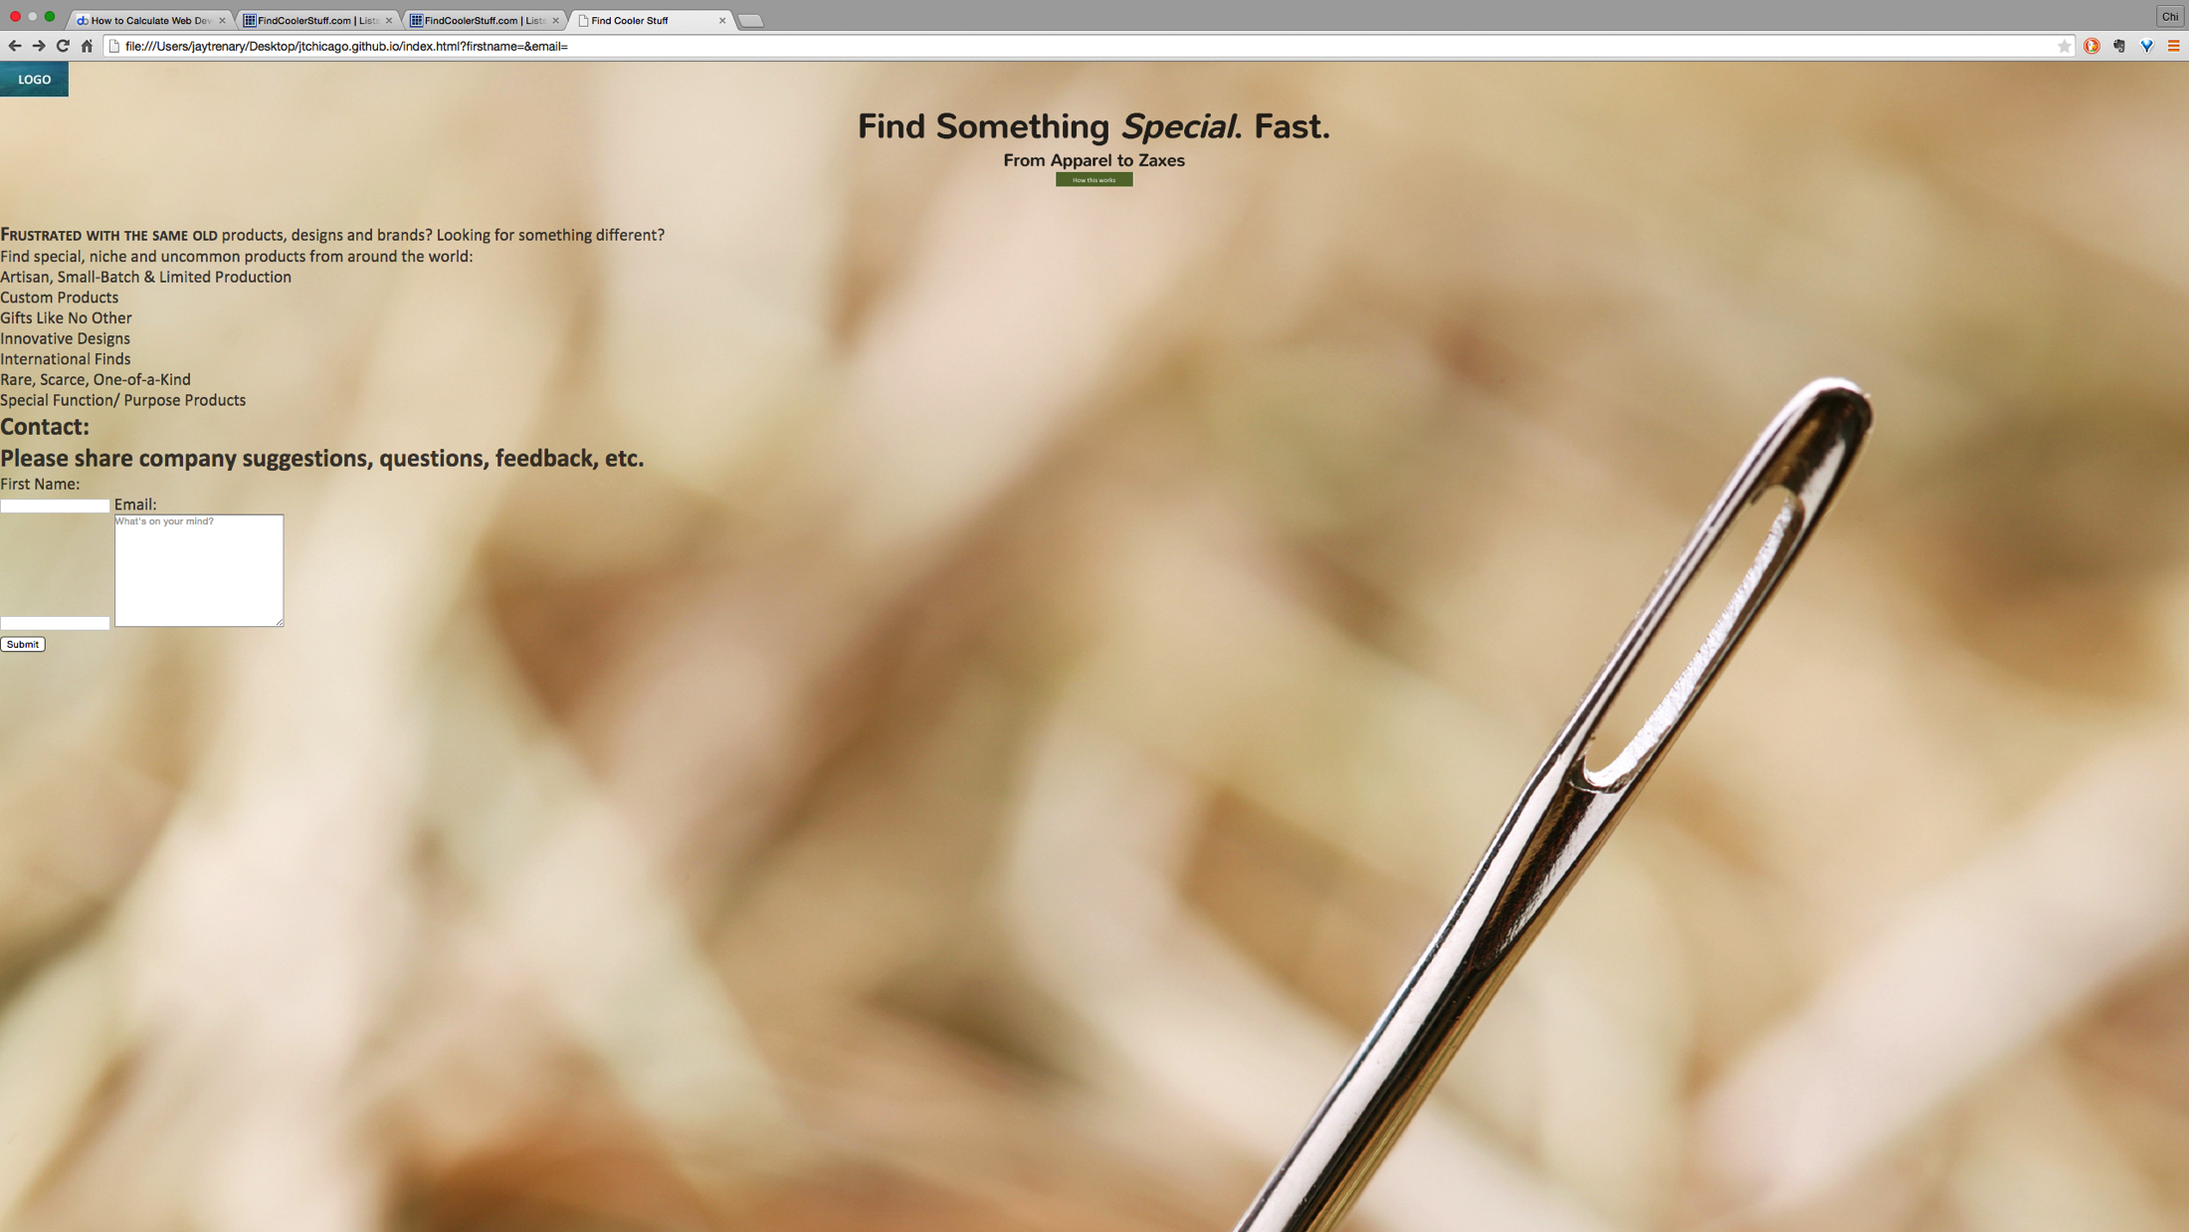
Test: Nunito
Settled on this one, for now, for the header section
Looks contemporary, but the rounded glyph edges/”corners” soften it and make it look a little more distinctive
I like that it’s uncluttered, not distracting, but a little different
I’m sure it varies a lot from person to person, but this font, though contemporary and sort of cool looking, for some reason (to me) conveys a simpler, more “welcoming” experience for the user on the site.

Slide 3
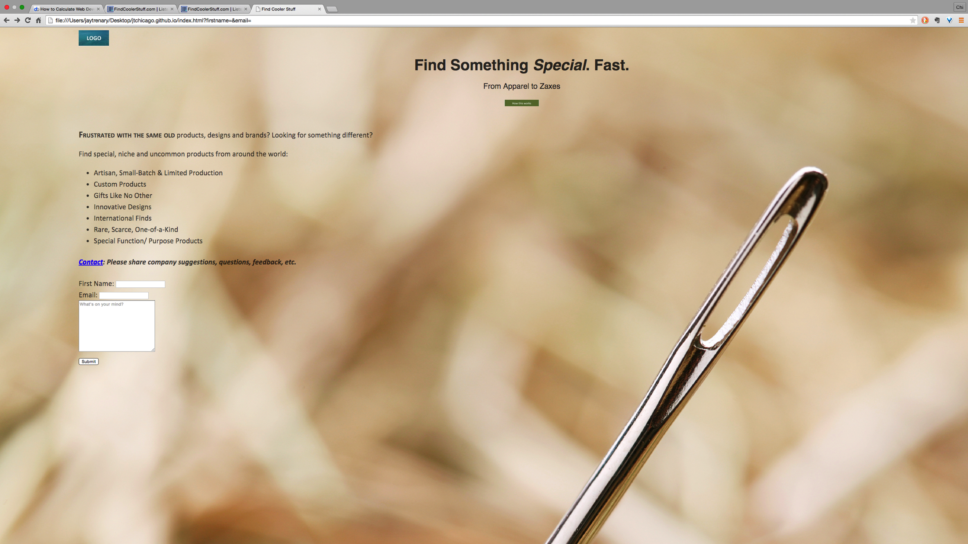
Original: Calibri
I only commented on the first two, but included shots of some others I tried

Slide 4

Test: Montserrat 400

Slide 5

Test: Montserrat 700

Slide 6
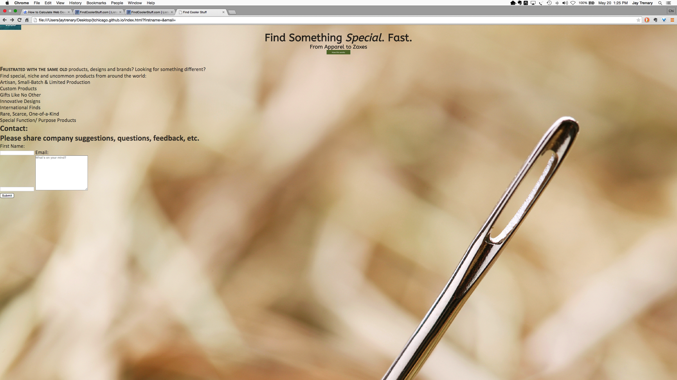
Test: ABeeZee
xx

Slide 7

Test: Cabin
xx

Slide 8
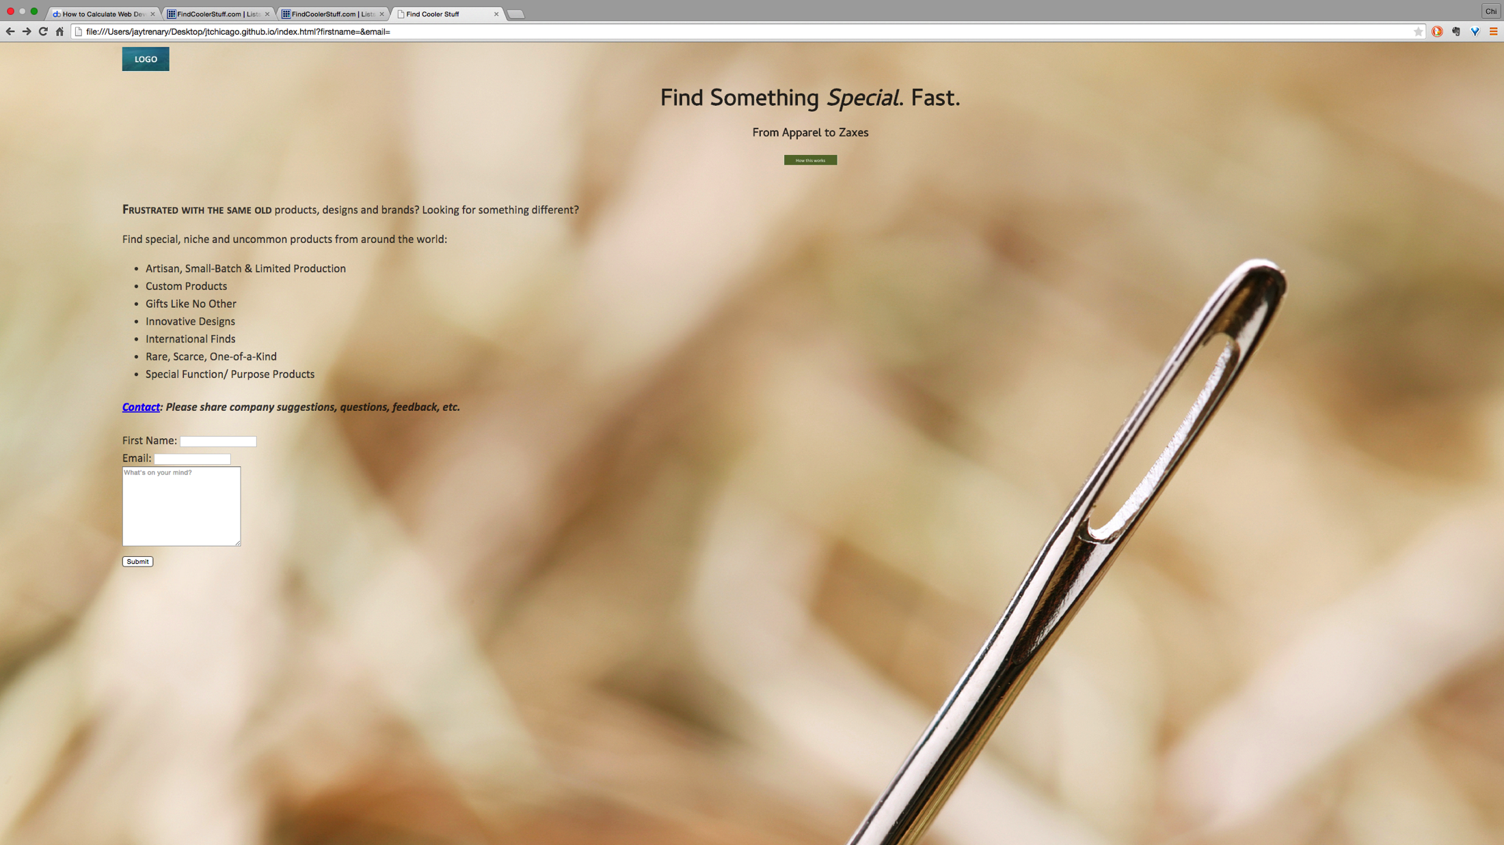
Test: Cambay Normal 400

Slide 9

Test: Cambay Bold 700

